Slide 1
Communicative
Approach 2
Prof Omer Maaitah

Slide 2
Problem statement
the urban life style ,the valuable issues and the low social interaction which have been generated from exploded population and diversity in the attitudes (the general well being of Sakan Kareem is weak).
Scope
Enhance the quality of life (livability).
Theme
Upgrading and creating communal spaces.

Slide 3
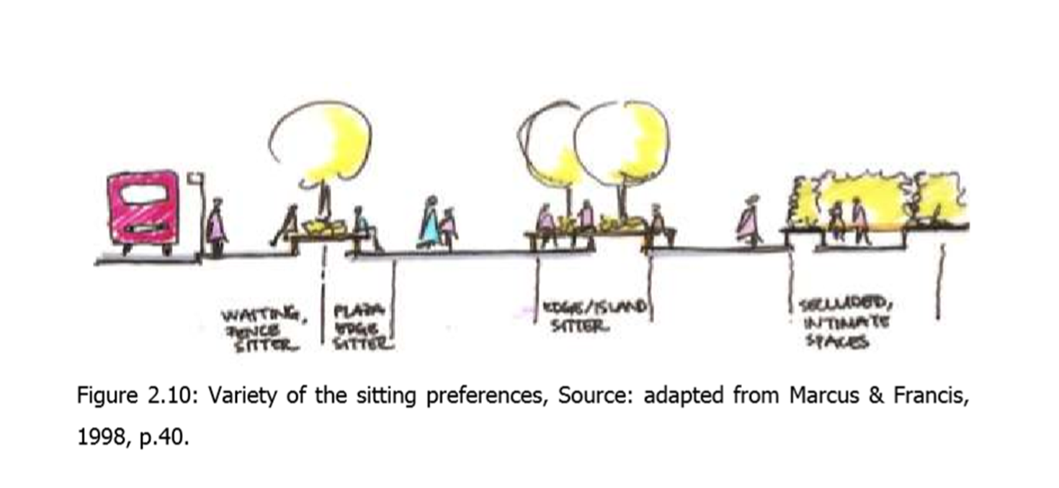
Liveability
Humanist streets & open spaces are domesticated and become liveable places for people. “ Open spaces and streets should be places and not corridors or balconies."
Humanistic approach
A Humanist or phenomenological theory of planning stresses the unique ways that different groups come to possess knowledge, and the difficulty with which one group’s knowledge can be translated for others given the diversity of human daily experiences, perspectives and behavior.

Slide 4
Framework
human
Environment
relations
Human
behaviour
Open spaces
concept
relations
context

Slide 5
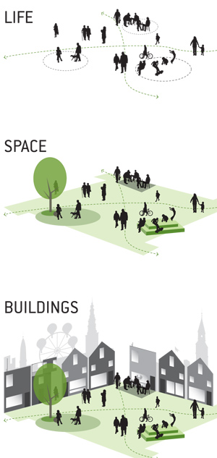
Experience
Meaning
Ability to be safe
Ability to make
change
Physical
Attributes
Activities
Place
SPACE
PLACE
Conception

Slide 6
WHAT IS PLACEMAKING
Place making inspires people to collectively reimagine and reinvent public spaces as the heart of every community.
Strengthening the connection between people and the places they share, place making refers to a collaborative process by which we can shape our public realm in order to maximize shared value.
place making facilitates creative patterns of use, paying particular attention to the physical, cultural, and social identities that define a place and support its ongoing evolution.
This approach pays attention to the opinions of the people living in a particular place and to discover their needs from this place and their aspirations towards it.

Slide 7
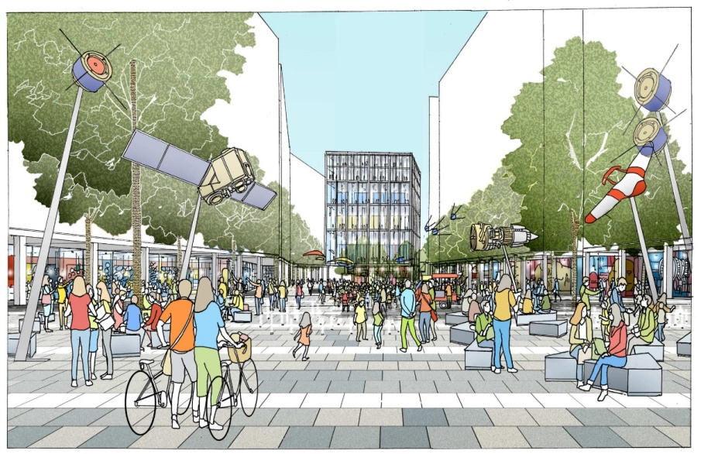
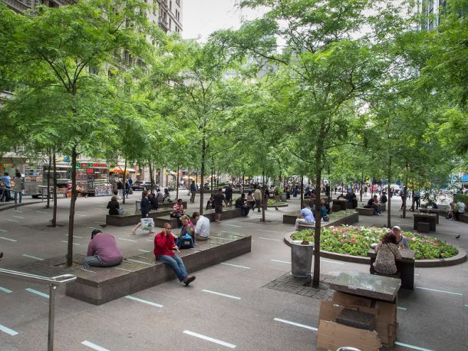
PRINCIPALS OF PLACEMAKING
1. IDENTITY: make innovation visible and public. 2. DIVERSITY: mix innovation with a range of other uses. 3. CONTINUITY: start with existing people and places. 4. SOCIABILITY: refers to the ability of a certain place to attract friends and neighbors to meet and sit together.
5. MOBILITY: connect to regions through multiple transportation modes.
6. FLEXIBILITY: experiment, observe, repeat.
7. UNITY: govern with vision and holistic, inclusive strategies
8.ACCESS & LINKAGES: Accessible place refers to how it’s available and easy to get to and get through the place, the availability of transportations to the place’s location, and the connection between the place and adjacent buildings.
9.COMFORT & IMAGE:A comfortable place makes a good impression for its visitors. With a beautiful image, safety, cleanliness and the availability of seats, comes a memorable impression.
10.USES & ACTIVITIES: Activities in a certain place attracts people to visit and to return back. A good place offers equality between men and women of different ages in its activities.

Slide 8
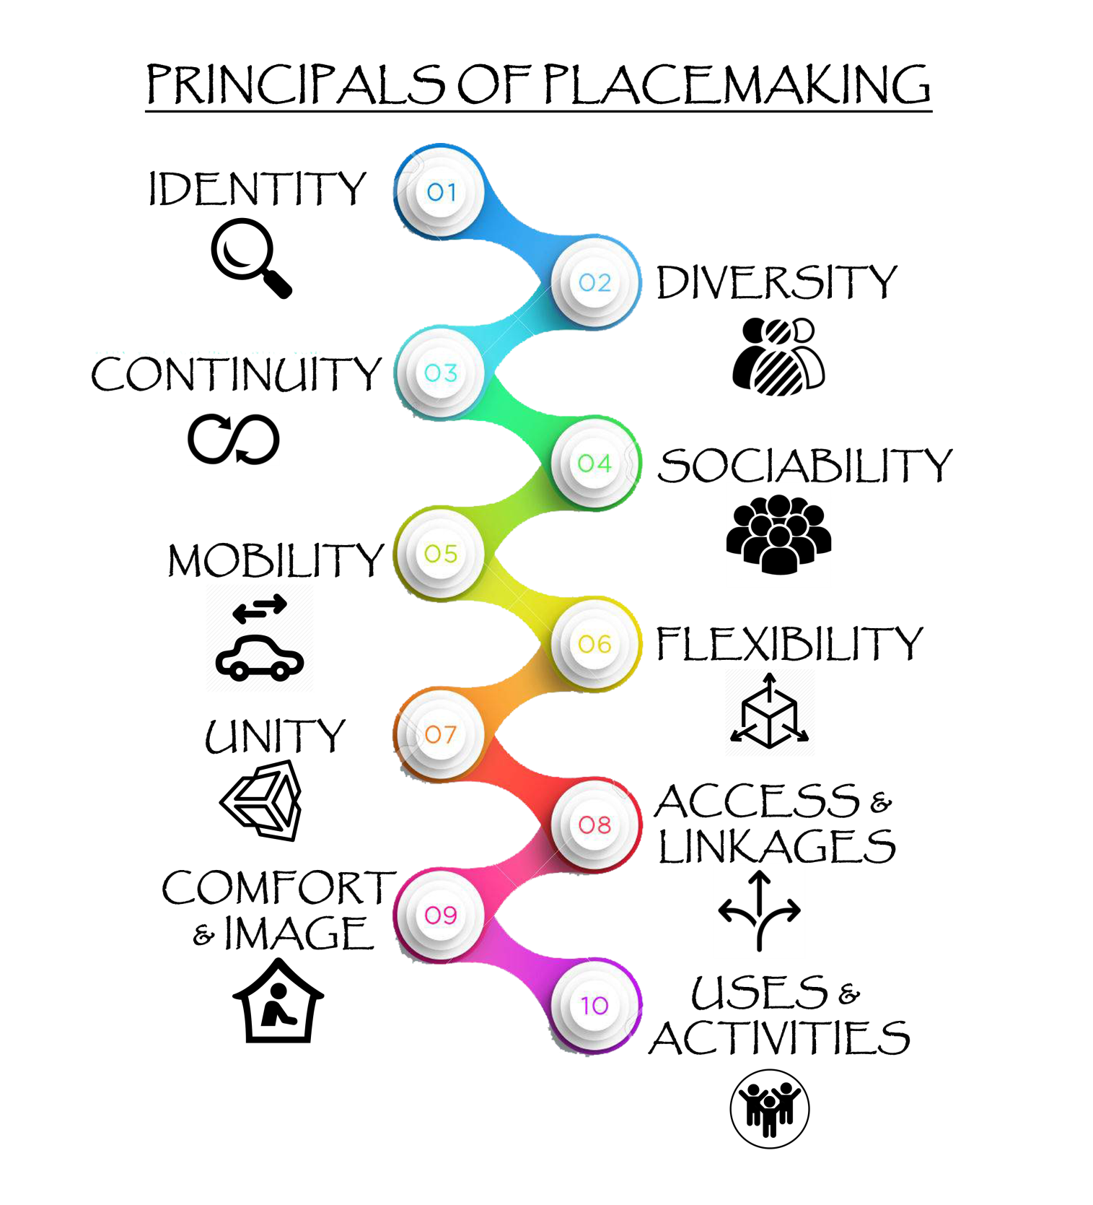

Slide 9
Well run
Active & Safe
Governance
Well connected
Social &
culture
Transport &
connectivity
PLACE
MAKING
Housing &Built
environment
Well designed
& built
service
Well served
Economy
Environment
Thriving
Equity
Environmentally
sensitive
Fair for everyone

Slide 10
PUBLIC OPEN SPACES
Social
value
Economic
value
Environmental
value
Improve quality of life.
Increased both real and perceived security and safety.
Promoted social equality and stability.
Increased cultural vitality.
Social integration and civic pride.
Reduced pollution (air, noise, water).
Increased ecological diversity .
Reduced energy consumption.
Increased economic vitality.
Reduce public expenditure on urban management .
Higher property prices.
Attracted capital.
Increased business confidence.

Slide 11
Places to sit: Primary and secondary sitting places

Slide 12
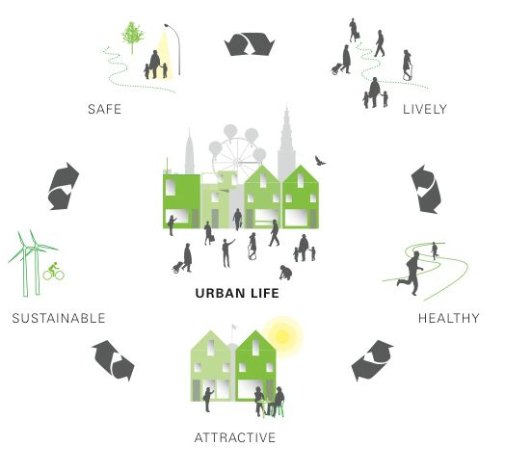
open spaces
open space is any usable space that's open to the public.
public space is “ the life between buildings ” together with such basic qualities as: “presence of other people, activities, events, inspiration, and stimulation”
It is essential to freedom of movement, quality of life, health and social connection in a city.
public space for play, activities, exercise, arts and music, community connection, conversation, family activities, personal reflection and getting fresh air, sun and a sense of natural connection.

Slide 13
Reflects the local culture
Social space
Promotes human contact
Open
Spaces
Promotes community involvement
Social
activities
high Sense
of place

